Slide 1
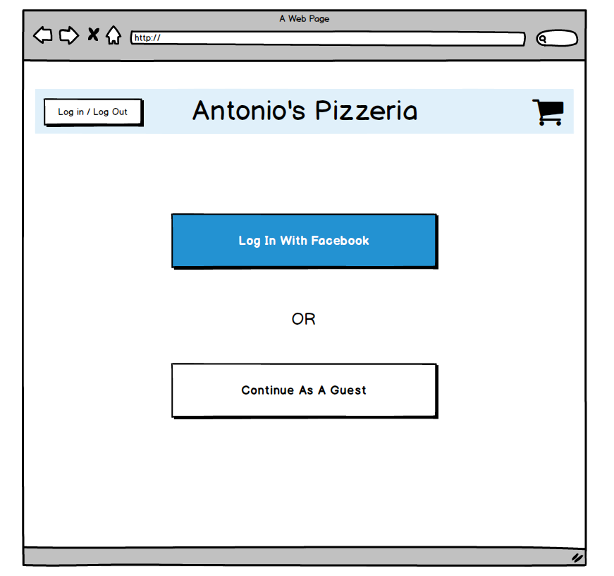
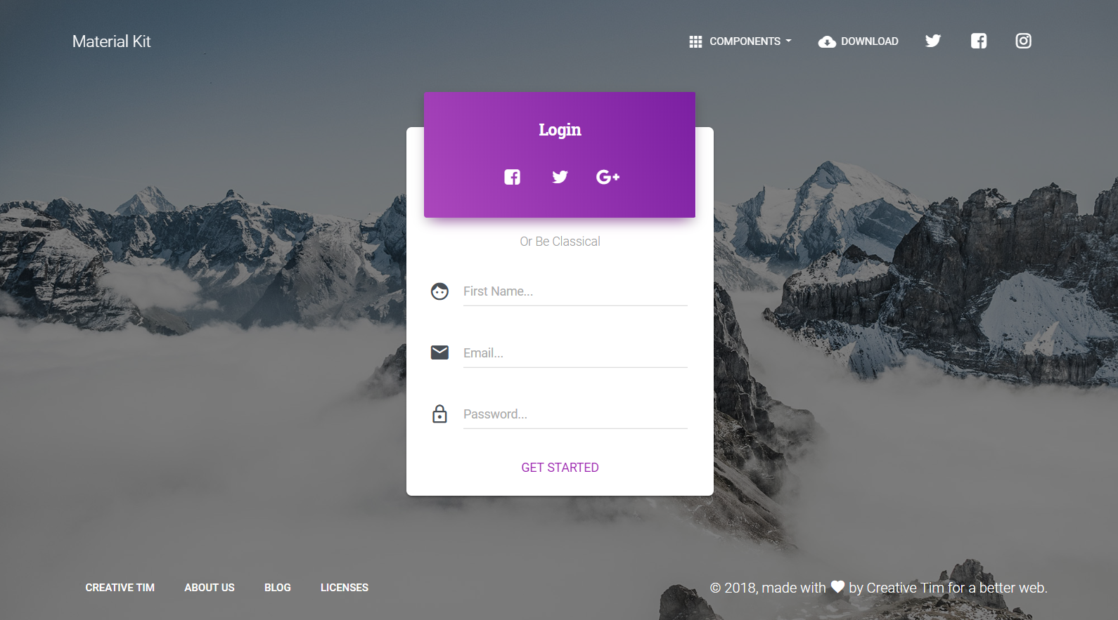


Page Name: Login
Use this color instea of the purple
Wireframe
Login using Facebook
Get Started

Slide 2
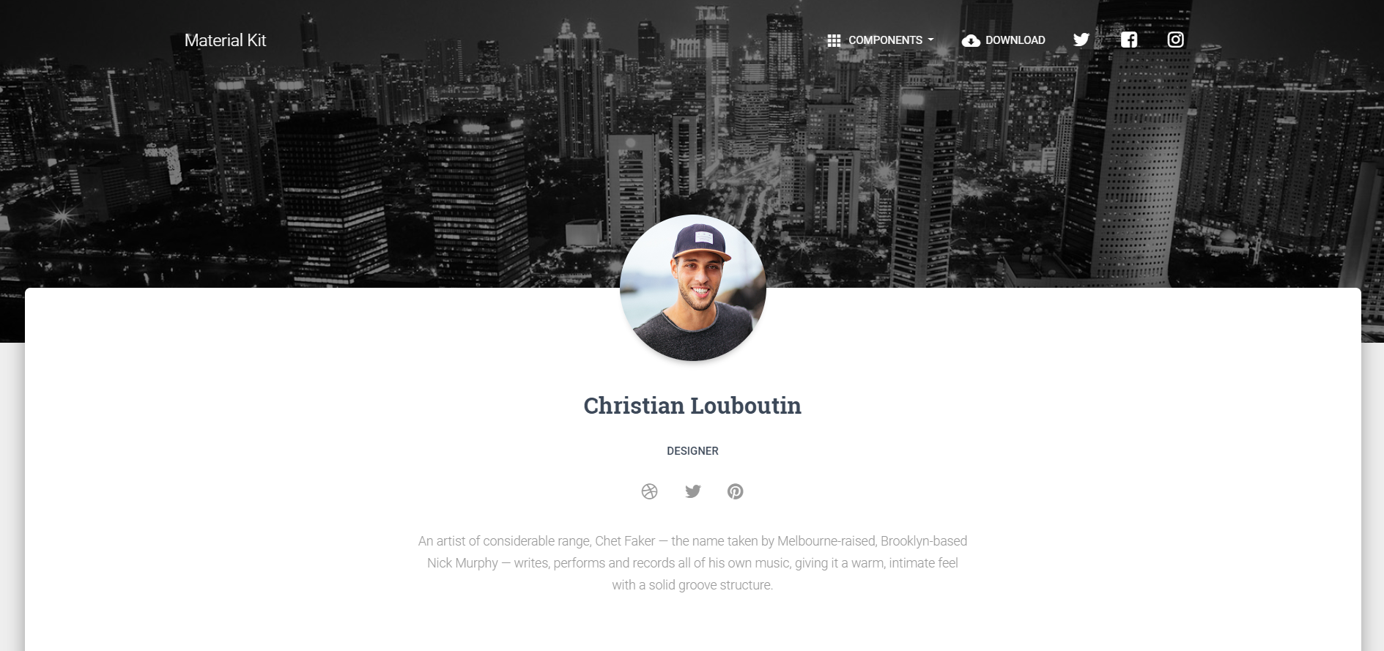
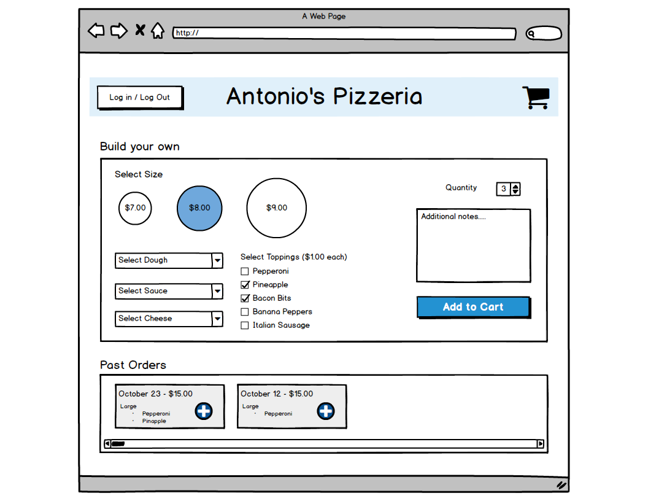
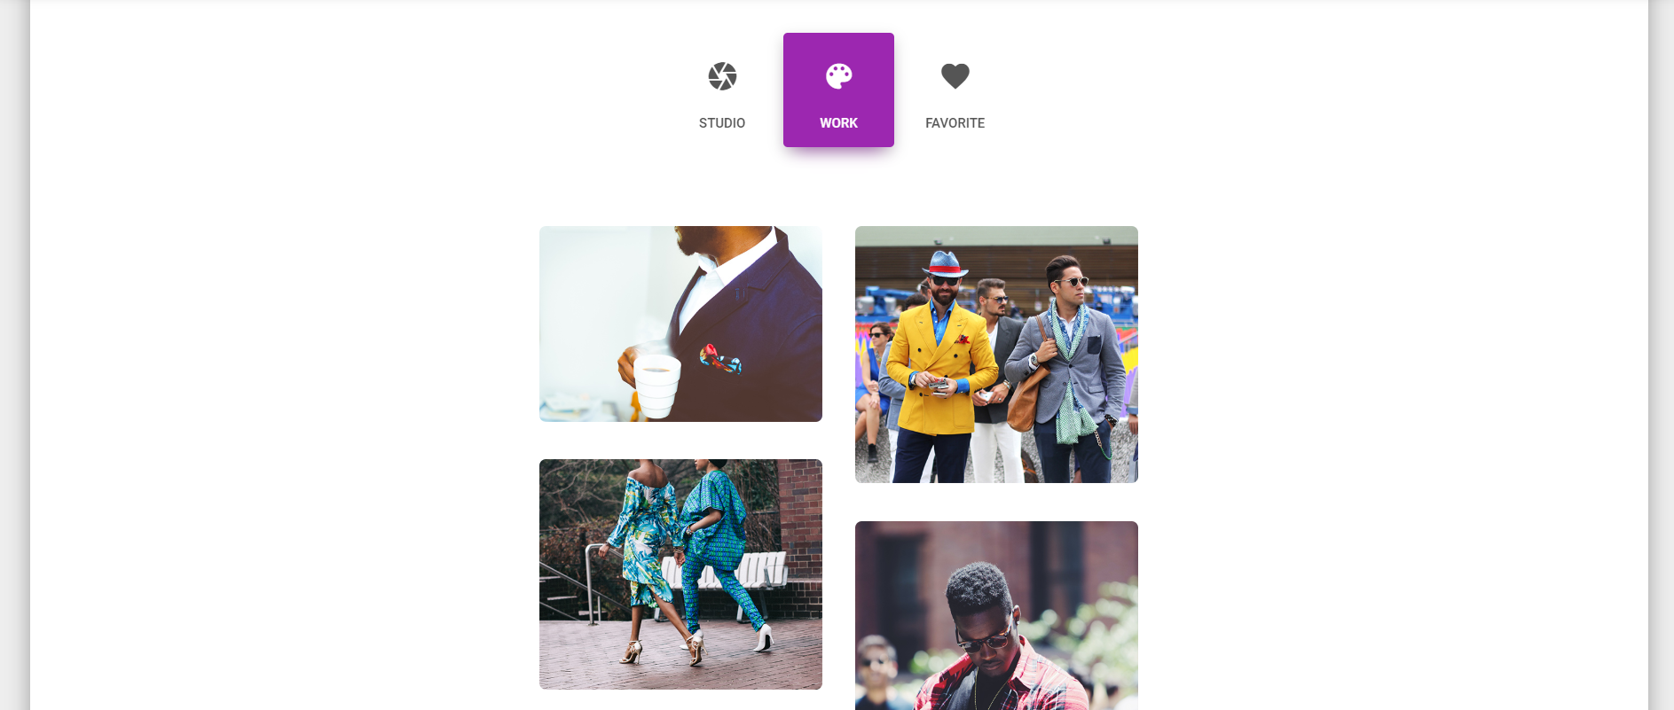
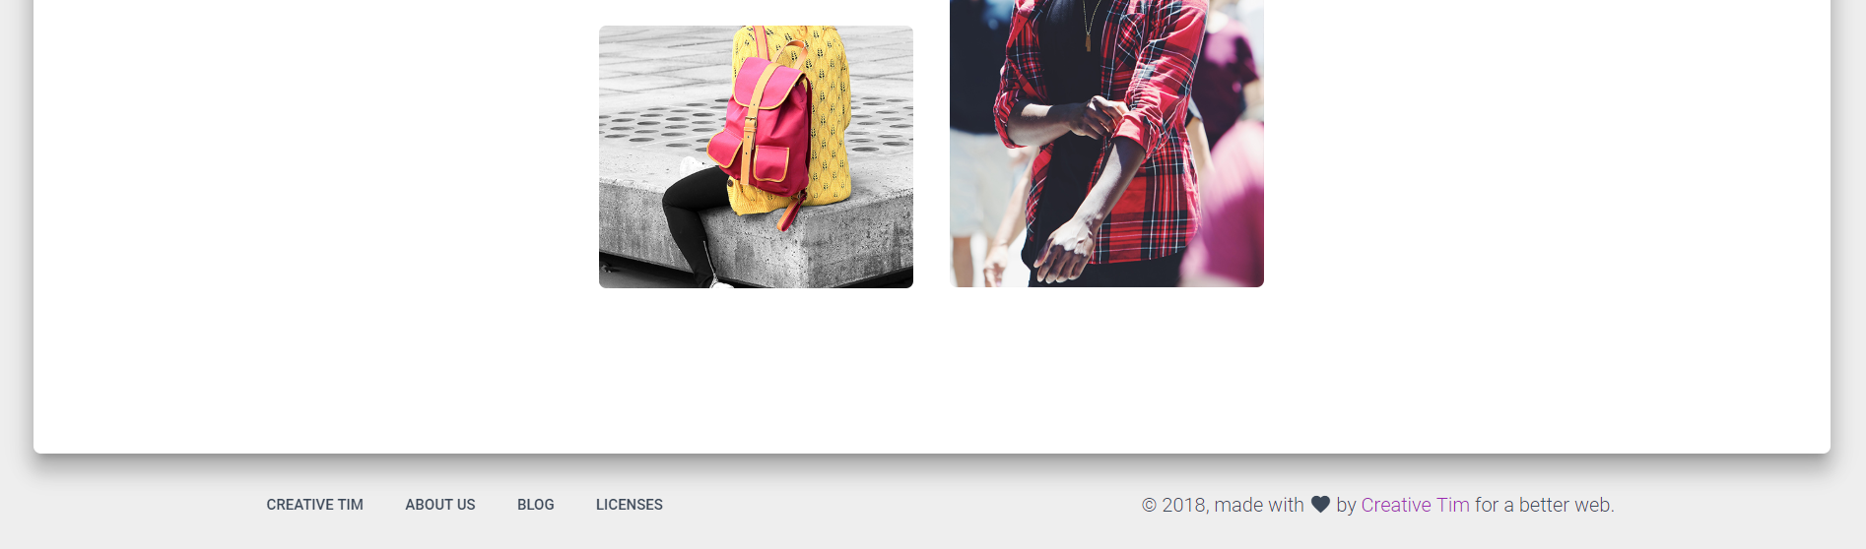
Page Name: Pizza Creation
Wireframe

Slide 3
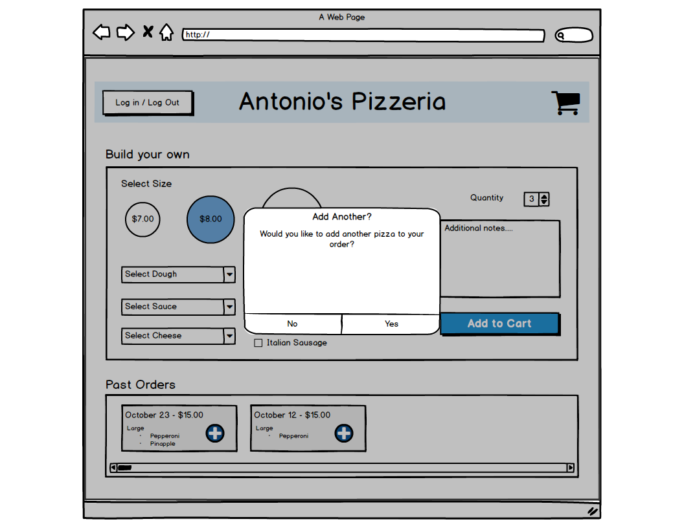
Page Name: Add Another Prompt
Wireframe

Slide 4
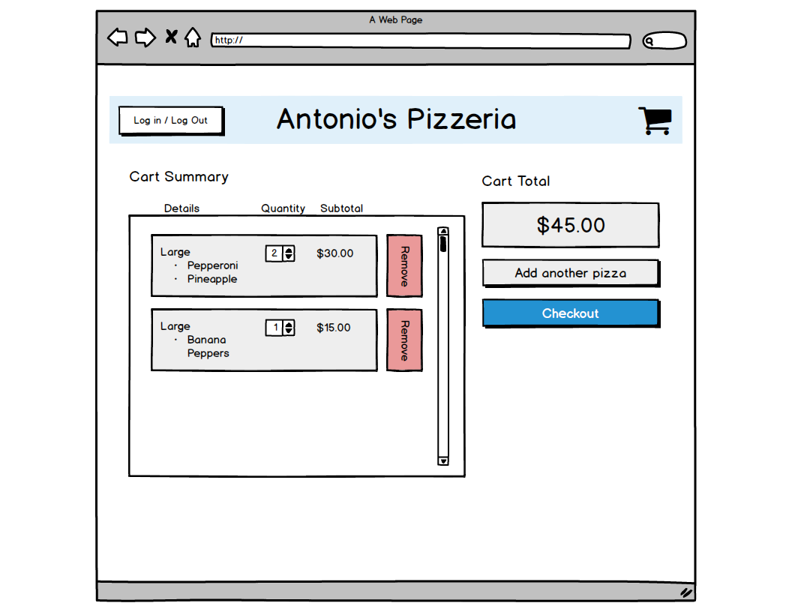
Page Name: Cart Summary
Wireframe

Slide 5
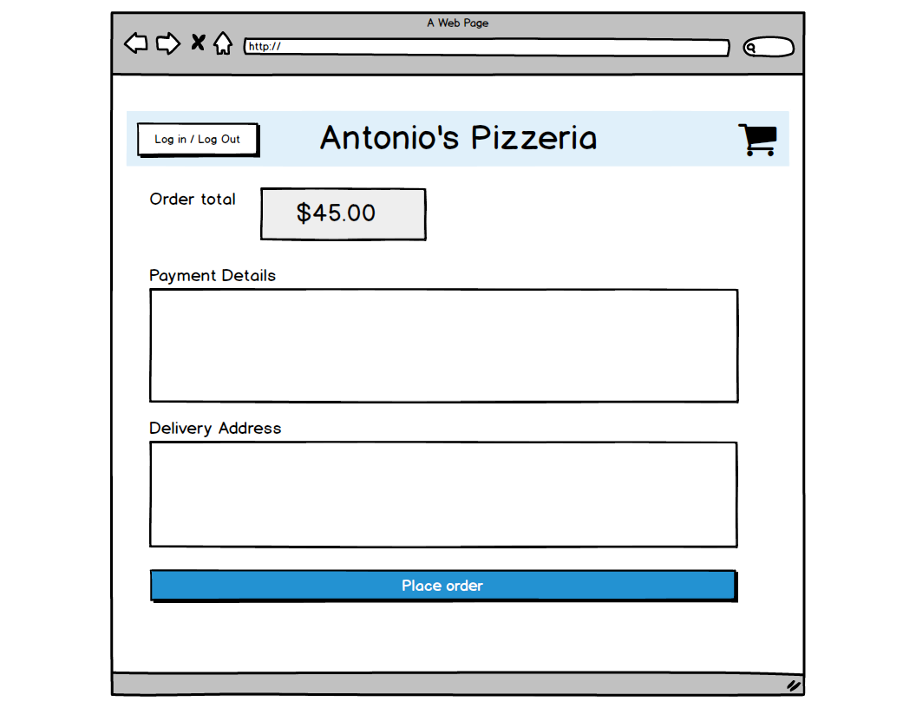
Page Name: Place Order
Wireframe

Slide 6
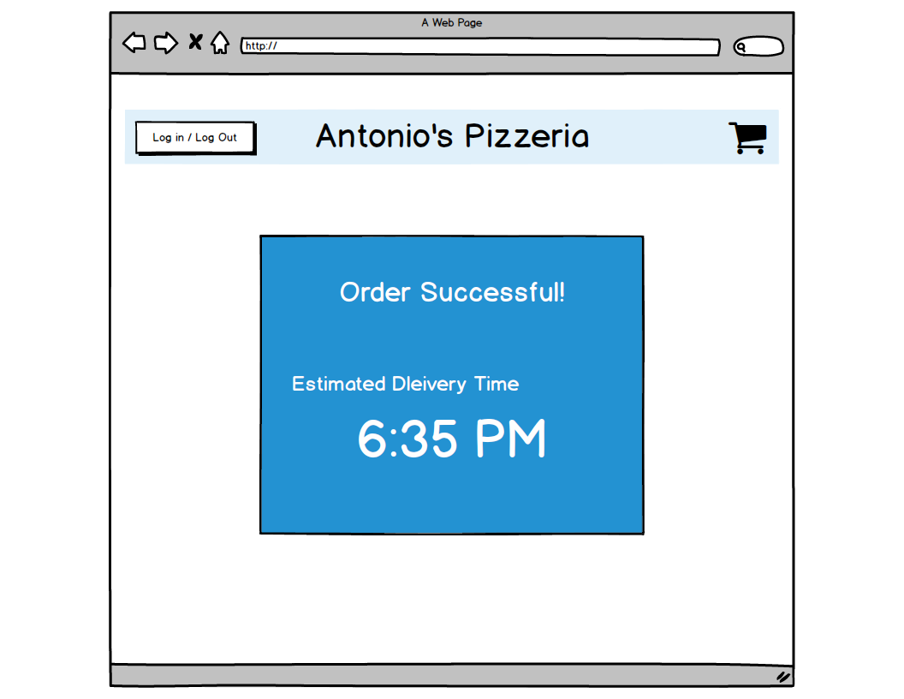
Page Name: Order Confirmation
Wireframe

